Slide 1
WAS SOMETHING IN THE FRUIT?
Robert Melashenko MD

Slide 2
We have many lessons to learn, and many, many to unlearn. God and heaven alone are infallible. Those who think that they will never have to give up a cherished view, never have occasion to change an opinion, will be disappointed. As long as we hold to our own ideas and opinions with determined persistency, we cannot have the unity for which Christ prayed. {CW 37.1}

Slide 3
In the series “The Science of Sin and Salvation”, Biblical and scientific evidence was presented linking Mobile Genetic Element’s (MGE’s) with the following phenomena:
Illness and Death (i.e. Cancer, Psychiatric disorders, Autoimmune disorders, selfish behavior, aging, and the “first” and “second” death, etc.)
Control of G-Protein Coupled Receptors. (Sensory Input/ Recievers)
Control of human reproduction
Reworking of brain circuitry
Complete infestation of our environment (including anything with a genome and even non-living substances such as water and air)

Slide 4
The relationship of MGE’s with virtually everything the Bible identifies as “sin” was presented, one question needs to be answered:
How and when did the MGE’s enter humanity and our biome?

Slide 5
The Bible clearly states that eating the fruit of the Tree of Knowledge of Good and Evil (TKGE) by Adam and Eve as the point in time in which this happened:
And the LORD God called to Adam, and said to him, Where are you? And he said, I heard your voice in the garden, and I was afraid, because I was naked; and I hid myself. And he said, Who told you that you were naked? Have you eaten of the tree, whereof I commanded you that you should not eat?
(Genesis 3:9-11 AKJV)

Slide 6
THE QUESTION THEN ARISES: COULD MGE’s HAVE BEEN IN THE TKGE’S FRUIT?

Slide 7
CLEARLY, THERE IS NO MECHANICAL REASON TO THWART TRANSMISSION OF MGE’s VIA THE FRUIT INTO ADAM AND EVE’s GENOME.
“The Science and Sin and Salvation” series also presented clear evidence that MGE’s in food are absorbed intact and fully functional from the human GI tract, into the bloodstream, and finally in the cells themselves. In rodents, evidence has been shown that ingested protein coding segments of DNA are found in the cells of the recipient intact where they are transcribed and translated into fully functioning proteins.

Slide 8
Does the Bible indicate whether something was in the fruit?
And the LORD God commanded the man, saying, Of every tree of the garden you may freely eat: But of the tree of the knowledge of good and evil, you shall not eat of it: for in the day that you eat thereof you shall surely die.
(Genesis 2:16-17 AKJV)
And the LORD God said, Behold, the man is become as one of us, to know good and evil: and now, lest he put forth his hand, and take also of the tree of life, and eat, and live for ever: Therefore the LORD God sent him forth from the garden of Eden, to till the ground from from where he was taken. So he drove out the man; and he placed at the east of the garden of Eden Cherubim, and a flaming sword which turned every way, to keep the way of the tree of life.
(Genesis 3:22-24 AKJV)

Slide 9
Does EGW address the topic?
There was nothing poisonous in the fruit of the tree of knowledge itself, nothing that would cause death in partaking of it. The tree had been placed in the garden to test their loyalty to God.
{ST, February 13, 1896 par. 6}
Many have tried to prove that there was some peculiar quality in the tree which called for this prohibition, but this was not the case. The fruit of the tree of knowledge was not in itself injurious. It was used merely as a test of their obedience to God. Will they be obedient to God's requirements, or not? We find that Satan came then, just as he comes today, with temptations upon the point of appetite. {9MR 232.2}

Slide 10
A compassionate God gave no severe test, no strong temptation that would tax human endurance beyond the power to resist. The fruit itself was harmless. If God had not forbidden Adam and Eve to partake of the fruit of the tree of knowledge, their action in taking it would not have been sinful. Up to the moment of God's prohibition, Adam might have eaten of the fruit of that tree without realizing any harm. But after God had said, Thou shalt not eat, the act became a crime of great magnitude.
If I had not come and spoken to them, they had not had sin: but now they have no cloak for their sin.
(John 15:22 AKJV)
It would have been unworthy of man as an intelligent being, and would have sustained Satan's charge of God's arbitrary rule. {CC 13.3}

Slide 11
But EGW also says:
Remedies That Cleanse the System.--Christ never planted the seeds of death in the system. Satan planted these seeds when he tempted Adam to eat of the tree of knowledge which meant disobedience to God. Not one noxious plant was placed in the Lord's great garden, but after Adam and Eve sinned, poisonous herbs sprang up. In the parable of the sower the question was asked the master, "Didst not thou sow good seed in thy field? from whence then hath it tares?" The master answered, "An enemy hath done this" (Matt. 13:27, 28). All tares are sown by the evil one. Every noxious herb is of his sowing, and by his ingenious methods of amalgamation he has corrupted the earth with tares. {2SM 288.2}
Because of man's sin, the earth was cursed. This was not an arbitrary curse, but God merely stated the inevitable consequence of Adam's sin. {June 22, 1899 EJW, PTUK 389.5}

Slide 12
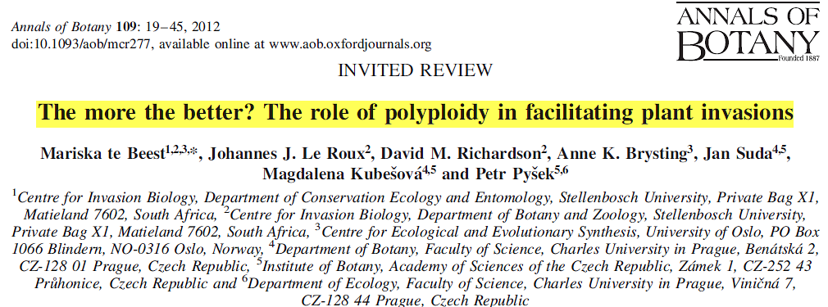
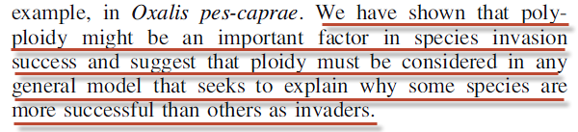

Slide 13
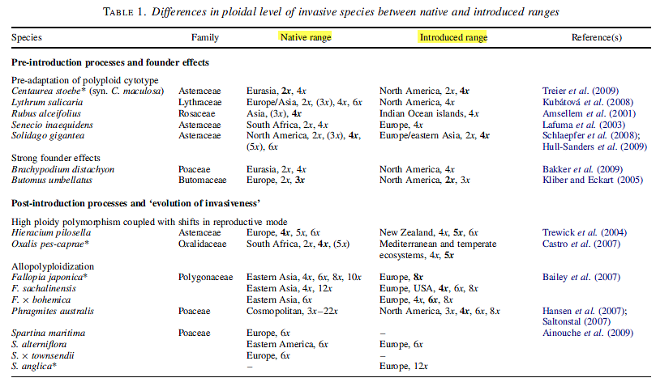
Annals of Botany 109: 19–45, 2012

Slide 14
Years ago the Lord revealed to me that institutions should be established for treating the sick without drugs. Man is God's property, and the ruin that has been made of the living habitation, the suffering caused by the seeds of death sown in the human system, are an offense to God. Letter 73, 1896. {MM 229.3}
In drooping flower and falling leaf Adam and his companion witnessed the first signs of decay. Vividly was brought to their minds the stern fact that every living thing must die. Even the air, upon which their life depended, bore the seeds of death. {Ed 26.3}
Rebellion and apostasy are in the very air we breathe. We shall be affected by them unless we by faith hang our helpless souls upon Christ.
(Selected Messages, book 2, pp. 394, 395)

Slide 15

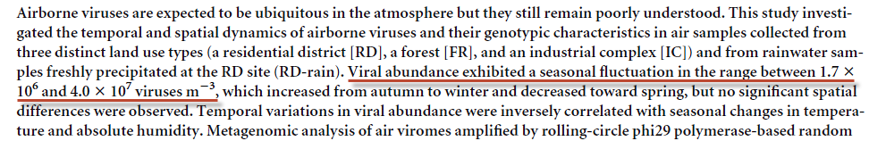
(1,700,000 – 40,000,000)
Journal of Virology August 2012 Volume 86 Number 15

Slide 16
Eve had wandered near the forbidden tree, and her curiosity was aroused to know how death could be concealed in the fruit of this fair tree. {RH, February 24, 1874 par. 12}
Continually they were reminded also of their lost dominion. Among the lower creatures Adam had stood as king, and so long as he remained loyal to God, all nature acknowledged his rule; but when he transgressed, this dominion was forfeited. The spirit of rebellion, to which he himself had given entrance, extended throughout the animal creation. Thus not only the life of man, but the nature of the beasts, the trees of the forest, the grass of the field, the very air he breathed, all told the sad lesson of the knowledge of evil. {Ed 26.4}

Slide 17
When Christ came, it was to a world disloyal to God--a world all seared and marred by the curse of rebellion. Since the fall, the arch-deceiver had carried on his work with intense vigor, until the curse of transgression had fallen heavily upon the earth. Men were corrupted by Satan's inventions. {YI, June 2, 1898 par. 5}
Although the earth was blighted with the curse, nature was still to be man's lesson book. It could not now represent goodness only; for evil was everywhere present, marring earth and sea and air with its defiling touch. Where once was written only the character of God, the knowledge of good, was now written also the character of Satan, the knowledge of evil. From nature, which now revealed the knowledge of good and evil, man was continually to receive warning as to the results of sin. {Ed 26.2}

Slide 18
Her statements, at first blush, seem to be contradictory. Is there a way all the statements can be taken together and still make sense?

Slide 19
Communication 101
When people communicate, roughly 70% of the information exchanged is non-verbal. Hence, when reading a text, fully 70% of the content the speaker is trying to convey is lost. Consequently, when different people read the script, multiple divergent ideas can be gleaned from the same piece. The only way to obtain the original meaning that the author intended is to contact him/her to set the record straight— a luxury not afforded us.

Slide 20
“How Readest thou?”
Let him which is on the housetop not come down to take any thing out of his house:
(Matthew 24:17 KJV)
Let him which is on the house[top not come down] to take any thing out of his house:
(Matthew 24:17 KJV)

Slide 21
Here are other EGW statements that we should consider as relevant to the issue:
The fruit of the tree of life in the Garden of Eden possessed supernatural virtue. To eat of it was to live forever. Its fruit was the antidote of death. Its leaves were for the sustaining of life and immortality. But through man's disobedience death entered the world. {MM 233.5}

Slide 22
The tree of life was a type of the one great Source of immortality. Of Christ it is written, "In Him was life; and the life was the light of men." He is the fountain of life. Obedience to Him is the life-giving, vivifying power that gladdens the soul. Through sin man shut himself off from access to the tree of life. Now, life and immortality are brought to light through Jesus Christ. . . . {MM 233.6}

Slide 23
Not only was the fruit of the Tree of Life an antidote to the affects of the TKGE, it was required for immortal life even in a “sinless” state.
In order to possess an endless existence, man must continue to partake of the tree of life. Deprived of this, his vitality would gradually diminish until life should become extinct. {PP 60.3}
After his disobedience he was not suffered to eat of the tree of life and perpetuate a life of sin. In order for man to possess an endless life he must continue to eat of the fruit of the tree of life. Deprived of that tree, his life would gradually wear out. {1SP 69.1}

Slide 24
The ultimate cause of death for Adam and Eve was not eating the fruit of the TKGE, but being deprived of access to the Tree of Life.
And the LORD God said, Behold, the man is become as one of us, to know good and evil: and now, lest he put forth his hand, and take also of the tree of life, and eat, and live for ever:
Therefore the LORD God sent him forth from the garden of Eden, to till the ground from from where he was taken.
(Genesis 3:22-23 AKJV)

Slide 25
Is there any evidence that the TKGE was ever on the earth when the Tree of Life was not nearby to it?

Slide 26
THREE OPTIONS
God and the Adversary made an agreement that if Adam and Eve should eat of the TKGE, then God would escort the pair out of the Garden and allow the Devil access to them--and in the process deprive them of access to the Tree of Life.
Believing the Devil’s lies about God, caused such derangement of their minds, that the consequences of sin naturally flowed from purely mental causes--plus they would be denied access to the Tree of Life.
Something was in the fruit which would not cause death or injury to them, but would make it impossible for them to stay in the Garden.

Slide 27
Option Number One
God and the Adversary made an agreement that if Adam and Eve should eat of the TKGE, then God would escort the pair out of the Garden and allow the Devil access to them--and in the process deprive them of access to the Tree of Life.
Pros: EGW’s statements regarding nothing in fruit would be in complete agreement.
Cons: A) Physical changes in Adam and Eve prior to their expulsion from the Garden.
B) Why would reptiles (snakes in particular) who have no moral choice, have the largest per capita MGE load of any other animal? In fact, copperhead snakes are the only animal whose MGE infestation equals that of humans.

Slide 28
Option Number Two
Believing the Devil’s lies about God, caused such derangement of their minds, that the consequences of sin naturally flowed from purely mental causes--plus they would be denied access to the Tree of Life.
Pros: Compatible with statements about nothing in the fruit that causes harm or
death.
Cons: A) How did all living non human organisms become affected by sin when
presumably, they cannot believe a lie about God?
B) Since sin is inherited (Romans 5:12), it must be present in the genome. There is no known evidence that thinking changes DNA sequences in the neurons, much less non CNS or germ cells.

Slide 29
C) By EGW’s own accounts, Adam and Eve were genuinely sorry after being confronted by God, and there was no evidence that they still believed anything that the Devil had told Eve. So, in worst case scenario, they believed the lie for a few hours at most.
When Adam and Eve realized how exalted and sacred was the law of God, the transgression of which made so costly a sacrifice necessary to save them and their posterity from utter ruin, they pleaded to die themselves, or to let them and their posterity endure the penalty of their transgression, rather than that the beloved Son of God should make this great sacrifice. The anguish of Adam was increased. He saw that his sins were of so great magnitude as to involve fearful consequences. {LHU 23.5}

Slide 30
D) If thinking (or believing) something wrong about God was the cause of sin, why didn’t God warn them that “in the day that you think to eat, dying thou shalt die”? And why is it that every human since Adam and Eve has contracted a sinful predisposition via heredity (genome), and not via thinking processes (e.g. infants)?

Slide 31
E) How does one handle the following EGW statement if believing a lie is the entry point for sin?
From Adam's day to ours there has been a succession of falls, each greater than the last, in every species of crime. God did not create a race of beings so devoid of health, beauty, and moral power as now exists in the world. Disease of every kind has been fearfully increasing upon the race. This has not been by God's especial providence, but directly contrary to his will. It has come by man's disregard of the very means which God has ordained to shield him from the terrible evils existing. Obedience to God's law in every respect would save men from intemperance, licentiousness, and disease of every type. No one can violate natural law without suffering the penalty. {RH, March 4, 1875 par. 9}

Slide 32
Option Number Three
Something was in the fruit which would not cause death or injury to them, but would make it impossible for them to stay in the Garden.
Pros: The pros will be explained in the following scenario.
Cons: This is left up to you to decide.

Slide 33
Before constructing our scenario, we will need some further statements from EGW and science:
First of all, we need to note that the Devil did not wish to harm Adam and Eve, much less kill them. They were to be hostages to force God to pardon the Adversary and his angels.

Slide 34
His followers were seeking him; and he aroused himself, and assuming a look of defiance, informed them of his plans to wrest from God the noble Adam and his companion Eve. If he could in any way beguile them to disobedience, God would make some provision whereby they might be pardoned, and then himself and all the fallen angels would be in a fair way to share with them of God's mercy. If they should fail to obtain pardon, they could unite with Adam and Eve, whose transgression would place them also in a state of rebellion; and thus they could take possession of Eden, and hold it as their home. And if they could gain access to the tree of life in the midst of the garden, their strength would, they thought, be equal to that of the holy angels, and even God himself could not expel them. {ST, January 16, 1879 par. 13}

Slide 35
Secondly, the Devil wanted to have Adam and Eve eat of the TL because it would render them both immortal and eternally under his power.
It was Satan's studied plan that Adam and Eve should disobey God, receive his frown, and then partake of the tree of life, that they might perpetuate a life of sin. But holy angels were immediately commissioned to guard the way to the tree of life. Around these angels flashed beams of light on every side, which had the appearance of glittering swords. {ST, January 23, 1879 par. 13}

Slide 36
It was Satan's plan that Adam and Eve should by disobedience incur God's displeasure; and then, if they failed to obtain forgiveness, he hoped that they would eat of the tree of life, and thus perpetuate an existence of sin and misery. But after man's fall, holy angels were immediately commissioned to guard the tree of life. Around these angels flashed beams of light having the appearance of a glittering sword. None of the family of Adam were permitted to pass the barrier to partake of the life-giving fruit; hence there is not an immortal sinner. {PP 60.3}

Slide 37
The news of man's fall spread through Heaven--every harp was hushed. The angels cast their crowns from their heads in sorrow. All Heaven was in agitation. The angels were grieved at the base ingratitude of man, in return for the rich blessings which God had bestowed upon him. A council was held to see what must be done with the guilty pair. The angels feared that they would put forth the hand, and eat of the tree of life, and thus perpetuate a life of sin. {ST, January 23, 1879 par. 8}

Slide 38
Adam was driven from Eden, and the angels who, before his transgression, had been appointed to guard him in his Eden home, were now appointed to guard the gates of paradise and the way of the tree of life, lest he should return, gain access to the tree of life, and sin be immortalized. {Con 15.2}

Slide 39
Apparently, God removed the pair from the Garden for their own good. Had they been permitted to stay and eat of the TL’s fruit there would have been no plan of salvation available to redeem them!
Adam listened to the words of the tempter, and yielding to his insinuations, fell into sin. Why was not the death penalty at once enforced in his case?--Because a ransom was found. God's only begotten Son volunteered to take the sin of man upon himself, and to make an atonement for the fallen race. There could have been no pardon for sin had this atonement not been made. Had God pardoned Adam's sin without an atonement, sin would have been immortalized, and would have been perpetuated with a boldness that would have been without restraint. {RH, April 23, 1901 par. 9}

Slide 40
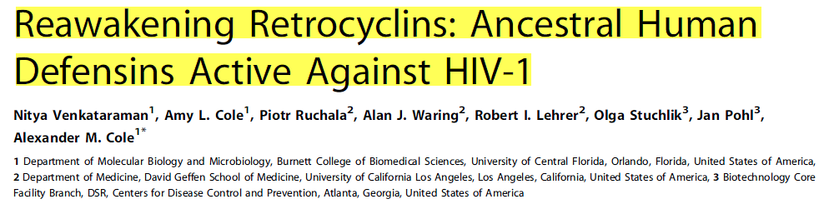
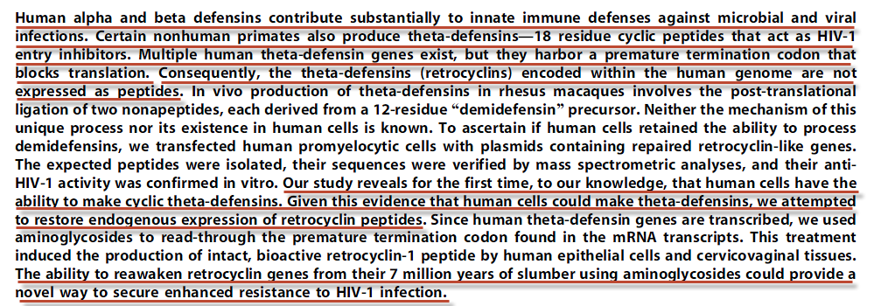
Third, we now look to science to see if it can shed any light that may have in the TKGE’s fruit.
PLoS Biology April 2009 | Volume 7

Slide 41
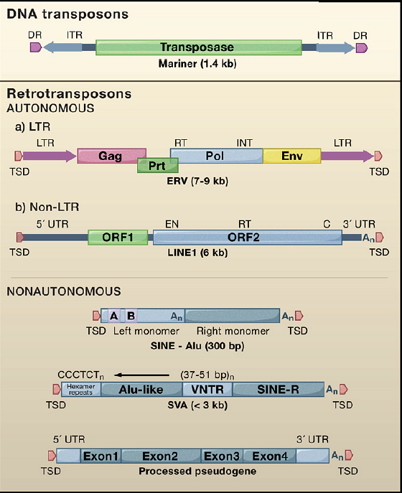
Retrotransposons Revisited: The Restraint and Rehabilitation of Parasites
John L. Goodier , Haig H. Kazazian Jr.
Figure 1 Types of Transposable Elements in Mammals Mariner-like DNA transposons are inactive relics in mammalian genomes. Retrotransposons that contain many, but not all, of the activities necessary for their mobility are called autonomous.
Cell Volume 135, Issue 1 2008 23 - 35

Slide 42
Now putting everything together:
The Devil is informed that Christ can do nothing to allow him and his apostate angels back into heaven during a meeting outside of the New Jerusalem.
Satan then devises a plan whereby he feels that he can force God’s hand into devising a way in which he and his followers can be reinstated into heaven.

Slide 43
This plan is to have Adam and Eve eat of the TKGE wherein the Devil has placed DNA MGE’s. Once Adam and Eve are inoculated, God will not let them perish and will devise a plan whereby the pairs information system can be remedied. Among other potentially unknown tasks, the MGE’s in the fruit were engineered to destroy their innate defenses against RNA MGE’s.
The MGE’s in the fruit are not engineered to cause death or cause physical injury. {ST, February 13, 1896 par. 6} . {9MR 232.2} They do, however, render Adam and Eve his hostages, for he now has the ability to invade their genomes with very virulent forms of MGE’s capable of entirely rewriting their code (theta defensins silenced).

Slide 44
Adam and Eve were informed that they must lose their Eden home. They had yielded to Satan's deception, and believed that God would lie. By their transgression they had opened a way for Satan to gain access to them more readily, and it was not safe for them to remain in the garden of Eden, lest in their state of sin they gain access to the tree of life, and perpetuate a life of sin. They entreated to be permitted to remain, although they acknowledged that they had forfeited all right to blissful Eden. They promised that they would in the future yield implicit obedience to God. They were informed that in their fall from innocence to guilt, they had gained no strength, but great weakness. They had not preserved their integrity while they were in a state of holy, happy innocence, and they would have far less strength to remain true and loyal in a state of conscious guilt. At these words the unhappy pair were filled with keenest anguish and remorse. They now realized that the penalty of sin was death. {ST, January 23, 1879 par. 12}

Slide 45
If God devises a way to remove the MGE’s from Adam and Eve, then the Devil and his companions can demand the same be done to them. If God does not comply, then the plan is for Adam and Eve to eat of the TL and be eternally rendered under his control. They and their children will supply a ready army to aid in the upcoming civil war. Also, the fruit of the TL could make Satan and his followers “stronger” so that next time they meet Christ and the loyal angels in battle, the Devil will fare better.

Slide 46
His followers were seeking him; and he aroused himself, and assuming a look of defiance, informed them of his plans to wrest from God the noble Adam and his companion Eve. If he could in any way beguile them to disobedience, God would make some provision whereby they might be pardoned, and then himself and all the fallen angels would be in a fair way to share with them of God's mercy. If they should fail to obtain pardon, they could unite with Adam and Eve, whose transgression would place them also in a state of rebellion; and thus they could take possession of Eden, and hold it as their home. And if they could gain access to the tree of life in the midst of the garden, their strength would, they thought, be equal to that of the holy angels, and even God himself could not expel them. {ST, January 16, 1879 par. 13}

Slide 47
Adam and Eve partake of the forbidden fruit. Their two guardian angels immediately take up guard around the TL preventing the pair from gaining access to its fruit. God removes the pair from the Garden, and in so doing, preserves their ability to respond to a plan of salvation. {Con 15.2}

Slide 48
Realizing that God has responded with a totally unexpected option (because not only will the Devil’s code be limited in its expression, but God will prevail in the end—Genesis 3:15) and there will be no “dealing for the hostages”, the Devil turns all his energies into destroying God’s handiwork—especially Adam and Eve. The Devil then sequentially introduces new “models” of MGE’s (RNA) over time, each complimentary and better suited to cause addiction, injury and death, with the intent of totally deranging the human machinery. In so doing, he strikes back at God.
From Adam's day to ours there has been a succession of falls, each greater than the last, in every species of crime. God did not create a race of beings so devoid of health, beauty, and moral power as now exists in the world. Disease of every kind has been fearfully increasing upon the race. {RH, March 4, 1875 par. 9}

Slide 49
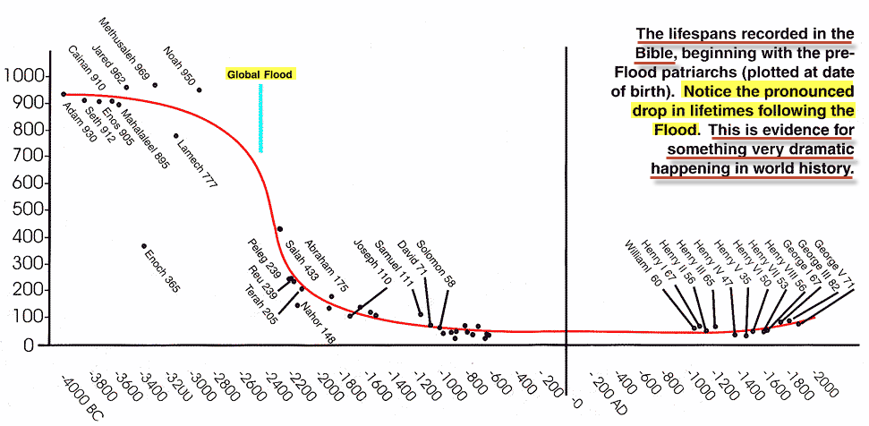

Slide 50
In summary, Adam and Eve were tested on the ultimate question:
WHO DO YOU CHOOSE TO PROGRAM YOU AND YOUR ENVIROMENT?
THIS IS AT THE VERY HEART OF THE GREAT CONTROVERSY, FOR THIS IS THE QUESTION THAT HAS BEEN POISED TO EVERY HUMAN BEING SINCE.

Slide 52
extras

Slide 53
How does one get around this text?
And I will put enmity between thee and the woman, and between thy seed and her seed; it shall bruise thy head, and thou shalt bruise his heel. (Gen 3:15)
What is the serpents seed? (Offspring is not credible)

Slide 54

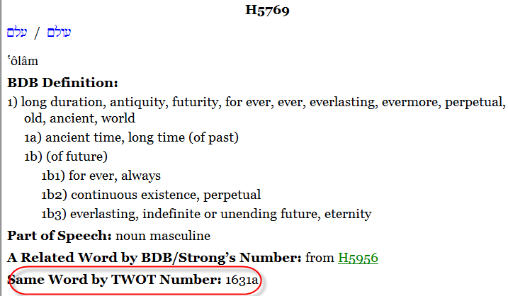
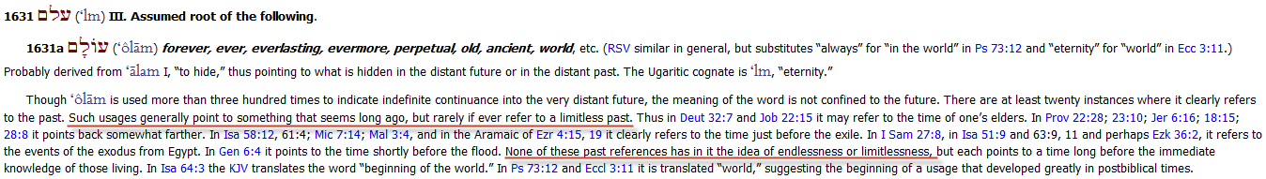
Theological Wordbook of the Old Testament

Slide 55
After their sin Adam and Eve were no longer to dwell in Eden. They earnestly entreated that they might remain in the home of their innocence and joy. They confessed that they had forfeited all right to that happy abode, but pledged themselves for the future to yield strict obedience to God.

Slide 56
When God placed Adam in Eden, He told him that he might eat of the fruit of every tree in the garden save one, the tree of knowledge of good and evil. Thus Adam's obedience was to be tested. God left him free to obey or disobey. He could have held him back from touching the forbidden fruit, but had He done this, Satan would have been sustained in saying that God's rule was arbitrary. Adam was left perfectly free. {RH, September 24, 1901 par. 5}

Slide 57
Man's great danger is in being self-deceived, indulging self-sufficiency, and thus separating from God, the source of his strength. Our natural tendencies, unless corrected by the Holy Spirit of God, have in them the seeds of moral death. . . .
{RC 311.6}

Slide 58
Adam regretted that Eve had left his side; but now the deed was done. He must be separated from her whose society he had loved so well. How could he have it thus? His love for Eve was strong, and in utter discouragement he resolved to share her fate. He reasoned that Eve was a part of himself; and if she must die, he would die with her; for he could not bear the thought of separation from her. He did not think that God, who had created him a living, beautiful form out of the dust of the ground, and had given him Eve to be his companion, could supply her place. After all, might not the words of this wise serpent be correct? Eve was before him, just as lovely and beautiful, and apparently as innocent, as before this act of disobedience. She expressed greater, higher love for him than before her disobedience, as the effect of the fruit she had eaten. He saw in her no signs of death. She had told him of the happy influence of the fruit, of her ardent love for him, and he decided to brave the consequences. He seized the fruit and quickly ate it, and, like Eve, felt not immediately its ill effects. {ST, January 23, 1879 par. 1}

Slide 59
In order for man to possess an endless life he must continue to eat of the fruit of the tree of life. Deprived of that tree, his life would gradually wear out.
{3SG 64.1}

Slide 60
Thus were revealed to Adam important events in the history of mankind, from the time when the divine sentence was pronounced in Eden, to the Flood, and onward to the first advent of the Son of God. He was shown that while the sacrifice of Christ would be of sufficient value to save the whole world, many would choose a life of sin rather than of repentance and obedience. Crime would increase through successive generations, and the curse of sin would rest more and more heavily upon the human race, upon the beasts, and upon the earth. The days of man would be shortened by his own course of sin; he would deteriorate in physical stature and endurance and in moral and intellectual power, until the world would be filled with misery of every type. {LHU 324.3}

Slide 61
And if they could gain access to the tree of life in the midst of the garden, their strength would, they thought, be equal to that of the holy angels, and even God himself could not expel them. {ST, January 16, 1879 par. 13}

Slide 62
From Adam's day to ours there has been a succession of falls, each greater than the last, in every species of crime. God did not create a race of beings so devoid of health, beauty, and moral power as now exists in the world. Disease of every kind has been fearfully increasing upon the race. This has not been by God's especial providence, but directly contrary to his will. It has come by man's disregard of the very means which God has ordained to shield him from the terrible evils existing. Obedience to God's law in every respect would save men from intemperance, licentiousness, and disease of every type. No one can violate natural law without suffering the penalty. {RH, March 4, 1875 par. 9}

Slide 63
From that time the race would be afflicted by Satan's temptations. {PP 59.3}

